Slide 1



Cut, awk,grep/egrep with examples

Slide 2
Debugging shell scripts:
Why debugging is important? The most basic step while debugging the script is, “echo”. You can “echo” the command on which you are using the variables so that you can check in the output section whether it is taking the right values or not.
#!/bin/bash var="opstree" echo "Hello, $var"

Slide 3
Debugging shell scripts:
Why debugging is important? The most basic step while debugging the script is, “echo”. You can “echo” the command on which you are using the variables so that you can check in the output section whether it is taking the right values or not.
root@localhost$ ./script.sh Hello, opstree

Slide 4
Debugging shell scripts:
For extensive debugging, we use “set” which is Bash’s built-in.
SET - X
The most common one is the -x option, it will run the script in debug mode. Set -x shows the command as well as its output on the terminal so that you would know for which command, the output is.

Slide 5
Debugging shell scripts:
SET - U
Sometimes you have not provided the variable, yet you have used it somewhere in the script. So, by default bash will ignore the variable that does not exist. So here, Script should report an error instead of continuing the execution silently.

Slide 6
Debugging shell scripts:
SET - E
Well, bash will throw an error on any wrong provided on the script, yet it will continue to command execute the remaining part of the script. However, we don’t want bash to accumulate the errors instead, it should stop executing the script on the first error, right away.

Slide 7



Debugging shell scripts:
SET - E

Slide 8
Debugging shell scripts:
SET- O PIPEFAIL
Set -e doesn’t apply to pipe commands because as we know “set -e” is determined by the return value & the pipe command will return the value of the last command, even if the first command fails.

Slide 9

Debugging shell scripts:
SET- O PIPEFAIL
#!/bin/bash
set -eo pipefail foo | echo "a" echo "bar"

Slide 10

Displaying more bash options
-o option is used with a set to display all the options, you can use whatever options that you want to make your script more robust in nature.

Slide 11
root@localhost$ set -o allexport off
braceexpand on
emacs on
errexit off
errtrace off
functrace off
hashall on
histexpand on
history on
ignoreeof off
interactive-comments on keyword off
monitor on
noclobber off

Slide 12

noexec noglob nolog notify nounset onecmd physical pipefail posix privileged verbose vi
xtrace
off off off off off off off off off off off off off

Slide 13
cut , awk grep, egrep with examples
cut:
Linux cut command is useful for selecting a specific column of a file. It is used to cut specific sections by byte position, character, and field and writes them to standard output. It cuts a line and extracts the text data.

Slide 14
cut:
It is necessary to pass an argument with it; otherwise, it will throw an error message. To cut a specific section, it is necessary to specify the delimiter. A delimiter will decide how the sections are separated in a text file. Delimiters can be a space (' '), a hyphen (-), a slash (/), or anything else. After '-f' option, the column number is mentioned.

Slide 15
Syntax:
cut OPTION... [FILE]...
Options:
The following command line options are used by the cut command to make it more specific:
-b, --bytes=LIST: It is used to cut a specific section by bytes.
-c, --characters=LIST: It is used to select the specified characters.

Slide 16
d, --delimiter=DELIM: It is used to cut a specific section by a delimiter.
-f, --fields=LIST: It is used to select the specific fields. It also prints any line that does not contain any delimiter character, unless the -s option is specified.
-n: It is used to ignore any option.
--complement: It is used to complement the set of selected bytes, characters or fields
-s, --only-delimited: It is used to not print lines that do not have delimiters.

Slide 17
--output-delimiter=STRING: This option is specified to use a STRING as an output delimiter; The default is to use "input delimiter".
-z, --zero-terminated: It is used if line delimiter is NUL, not newline.
--help: It is used to display the help manual.
--version: It is used to display the version information.

Slide 18
Examples of the cut command
Let's see the following examples of the cut command:
Cut by using Hyphen as a delimiter
Cut by using Space as a delimiter
Cut by byte position
Cut by character
Cut by complement pattern

Slide 19
Using Hyphen (-) As Delimiter
To cut by using the hyphen (-) as the delimiter, execute the below command:
cut -d- -f(columnNumber) <fileName>
Consider the following commands:
cut -d- -f2 marks.txt
cut -d- -f1 marks.txt
from the above commands, the output will be trimmed from the hyphen (-). Consider the below output:

Slide 20
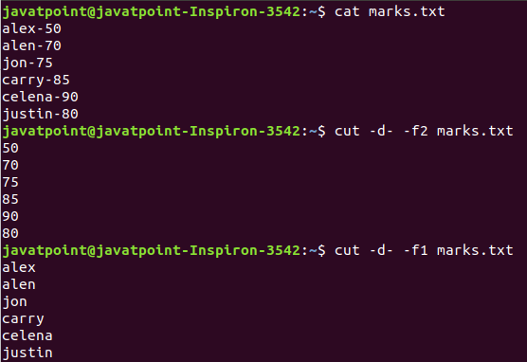

Slide 21
Using Hyphen (-) As Delimiter
cut -d ' ' -f(columnNumber) <fileName>
Consider the following commands:
cut -d ' ' -f2 exm.txt
cut -d ' ' -f5 exm.txt
From the above commands, the output will be trimmed after space for the specified column. The above commands will produce the output as follows:

Slide 22
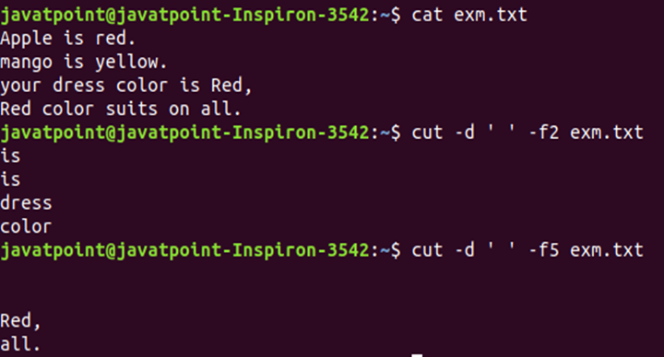
From the above output, our delimiter is space; hence we have used (' ') after (-d). Command "cut -d ' ' -f2 exm.txt" displays column 2, command "cut -d ' ' -f5 exm.txt" displays column 5.

Slide 23
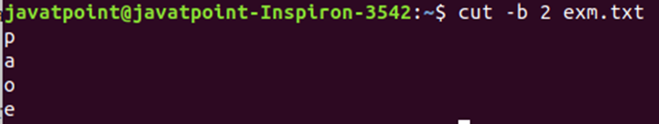
Cut by byte
The '-b' option is used to cut a section of line by byte. To cut a file by its byte position, execute the command as follows:
cut -b <byte number> <file name> Consider the below command:
cut -b 2 exm.txt
The above command will cut the line by a specified byte position. Consider the below output:

Slide 24
Cut by Character
The '-c' option is used to cut a specific section by character. However, these character arguments can be a number or a range of numbers, a list of comma- separated numbers, or any other character. To cut by a specified character, execute the command as follows:
cut -c < characters> <file name>
Consider the below commands:
cut -c 1,6 exm.txt
cut -c 1-3 exm.txtThe above commands will cut the line by the specified characters. Consider the below output:

Slide 25
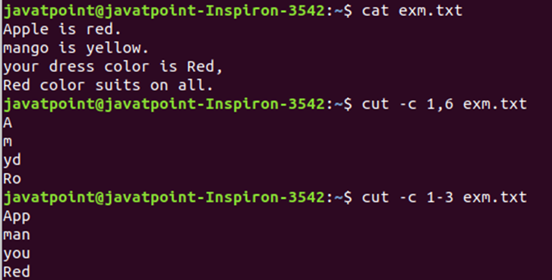
Cut by Character
The above commands will cut the line by the specified characters. Consider the below output:

Slide 26
From the above output, we can see the first command is cutting the first and sixth character from each line, and the second command is cutting the first to the third character from each line.
Cut by Complement Pattern
The '--complement' option is used to cut the compliment. This option is supported by the BSD version of the cut.
To cut by the complement pattern, execute the command as follows:
cut --
complement < complement pattern> <file name>
.

Slide 27
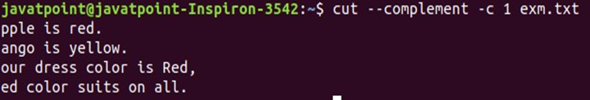
The compliment pattern can be a list of bytes, characters, or fields.
Consider the below command:
cut --complement -c 1 exm.txt
The above command will cut the file by the first character. Consider the below output:

Slide 28
awk:
The awk command is a Linux utility and programming language that enables users to analyze and alter data as well as generate prepared reports. The tool offers a variety of advanced text processing techniques and makes it easier to explain complicated data choices.

Slide 29
awk:
syntax
awk [options] 'selection_criteria {action}' input-file >
output-file
The available options are:
 | Option |  | Description
 | -F [separator] |  | Used to specify a file separator. The default separator is a blank space.
 | -f [filename] | Used to specify the file containing
the awk script. Reads the awk program source from the specified file, instead of the first command-line argument.
 | -v |  | Used to assign a variable.

Slide 30
awk:
make information retrieval and text manipulation easy to perform in Linux. For each pattern, users can specify an action to perform on each line that matches the specified pattern. Thus, using awk, users can easily process complex log files and output a readable report.

Slide 31
AWK Operations
It allows users to perform various operations on an input file or text. Some of the available operations are:
Scan a file line by line.
Split the input line/file into fields.
Compare the input line or fields with the specified pattern(s).
Perform various actions on the matched lines.
Format the output lines.

Slide 32
AWK Operations
Use control flow and loops on output.
Transform the files and data according to a specified structure.
Generate formatted reports.
AWK Statements
The command provides basic control flow statements (if-else, while, for, break) and also allows users to group statements using braces {}.

Slide 33
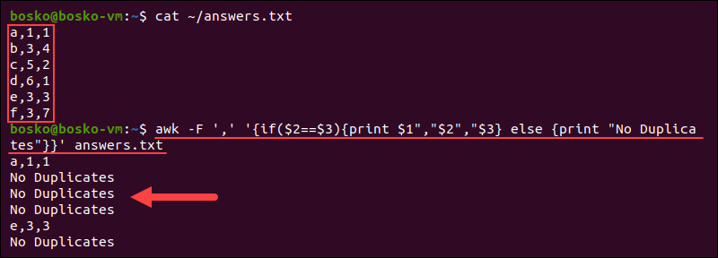
If-else
awk -F ',' '{if($2==$3){print $1","$2","$3} else {print "No
Duplicates"}}' answers.txt

Slide 34
The output shows the lines in which duplicates exist and states No duplicates if there are no duplicate answers in the line.

Slide 35
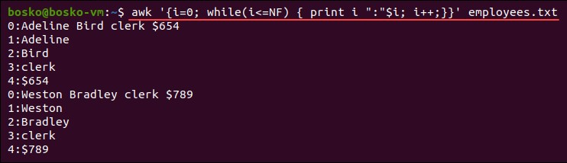
while
awk '{i=0; while(i<=NF) { print i ":"$i; i++;}}' employees.txt

Slide 36
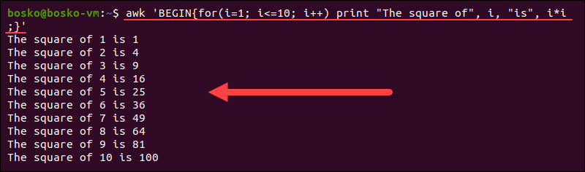
For
The for statement also works like that of C, allowing users to create a loop that needs to execute a specific number of times.
awk 'BEGIN{for(i=1; i<=10; i++) print "The square of", i,
"is", i*i;}'

Slide 37
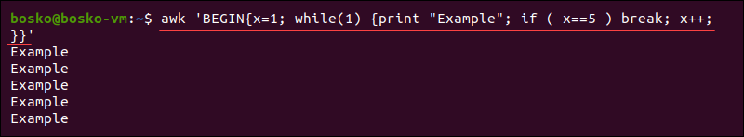
break
awk 'BEGIN{x=1; while(1) {print "Example"; if ( x==5 )
break; x++; }}'

Slide 38
AWK Variables
The awk command has built-in field variables, which break the input file into separate parts called fields.
The awk assignd the following variables to each data field:
$0. Used to specify the whole line.
$1. Specifies the first field.
$2. Specifies the second field.
etc…

Slide 39
AWK Variables
Other available built-in awk variables are:
NR. Counts the number of input records (usually lines). The awk command perform the pattern/action statements once for each record in a file.
awk '{print NR,$0}' employees.txt

Slide 40
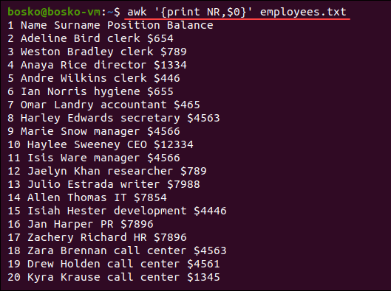
AWK Variables
Other available built-in awk variables are:
NR. Counts the number of input records (usually lines). The awk command perform the pattern/action statements once for each record in a file.
awk '{print NR,$0}' employees.txt

Slide 41
The command displays the line number in the output.
NF. Counts the number of fields in the current input record and displays the last field of the file.
For example:
awk '{print $NF}' employees.txt

Slide 42
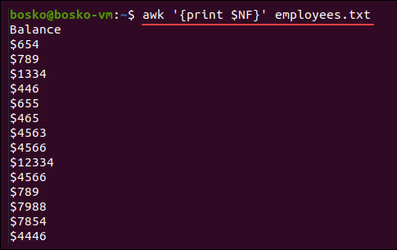
The command displays the line number in the output.
NF. Counts the number of fields in the current input record and displays the last field of the file.
For example:
awk '{print $NF}' employees.txt

Slide 43
FS. Contains the character used to divide fields on the input line. The default separator is space, but you can use FS to reassign the separator to another character (typically in BEGIN).
For example, you can make the etc/passwd file (user list) more readable by changing the separator from a colon (:) to a dash (/) and print out the field separator as well:
awk -FS 'BEGIN{FS=":"; OFS="-"} {print $0}' /etc/passwd

Slide 44
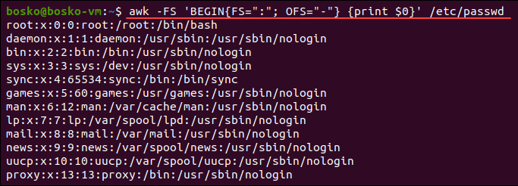
FS. Contains the character used to divide fields on the input line. The default separator is space, but you can use FS to reassign the separator to another character (typically in BEGIN).
\

Slide 45
RS. Stores the current record separator character. The default input line is the input record, which makes a newline the default record separator. The command is useful if the input is a comma- separated file (CSV).
awk 'BEGIN {FS="-"; RS=","; OFS=" owes Rs. "} {print $1,$2}'
debtors.txt

Slide 46
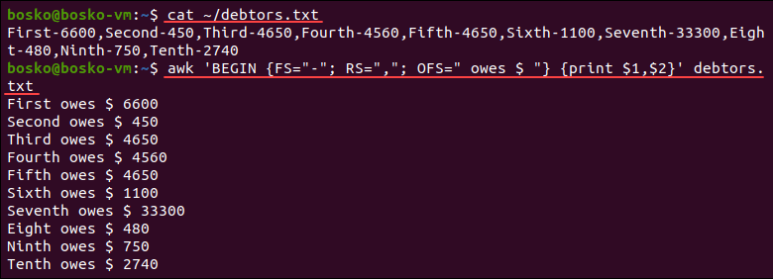
RS. Stores the current record separator character. The default input line is the input record, which makes a newline the default record separator. The command is useful if the input is a comma- separated file (CSV).
awk 'BEGIN {FS="-"; RS=","; OFS=" owes Rs. "} {print $1,$2}'
debtors.txt

